Slide 1
Flight Delays
(A closer look at five international US Airports)
August 12, 2024

Slide 2
Overview
Industry: Aviation
Main point: Determine causes and severity of airline delays to discover areas of improvement for 5 major U.S. airports.
Airports: Los Angeles International Airport, Hartsfield-Jackson Atlanta International Airport, Chicago O’Hare International Airport, Dallas Fort Worth International Airport and Denver International Airport.

Slide 3
Data Sourcing
Primary Data Source
GeoApify
Cleanup & Division
A Kaggle dataset that contains data on commercial flight delays from airports across the USA, all dated within January 2024.
A location platform that allowed us to pull data for each city and airport we took a closer look at.
"https://api.geoapify.com/v1/geocode/search"
We took our data file from Kaggle and trimmed down the columns we wanted to look at for our data, mainly flight origins and destinations, delay lengths, types of delays, and cancellations.
Afterwards, we filtered the data to 5 different cities contained the largest international airports in the US: Atlanta, Chicago, Dallas, Los Angeles, and Denver.
Each team member was assigned one of these cities to run analysis on.

Slide 4
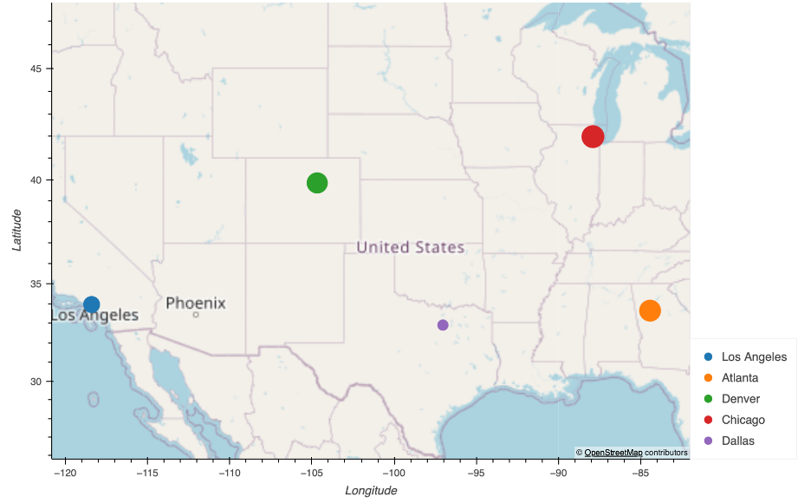
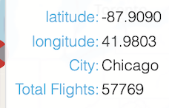
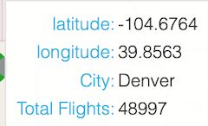
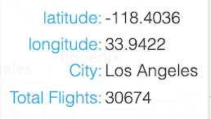
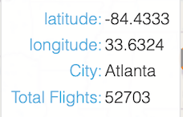
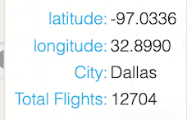
Geoapify Usage (opt)
This map is a heat map showing where in the United States each airport is located and sized off of how many flights came through each airport during our dataset. We used Geoapify.com to find the latitude and longitude for each airport to then plot them on the map.

Slide 5
Main Questions

Slide 6
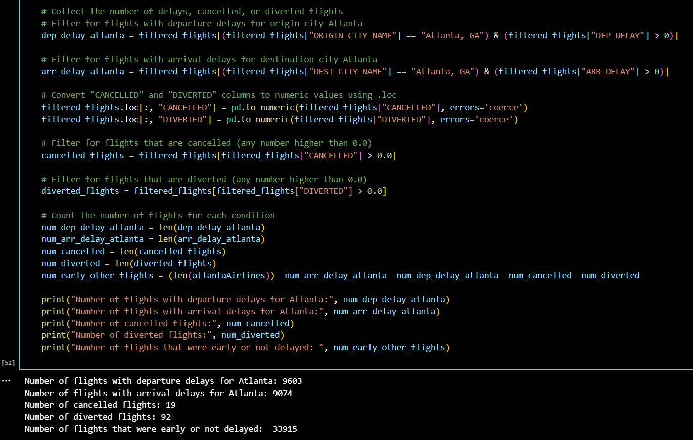
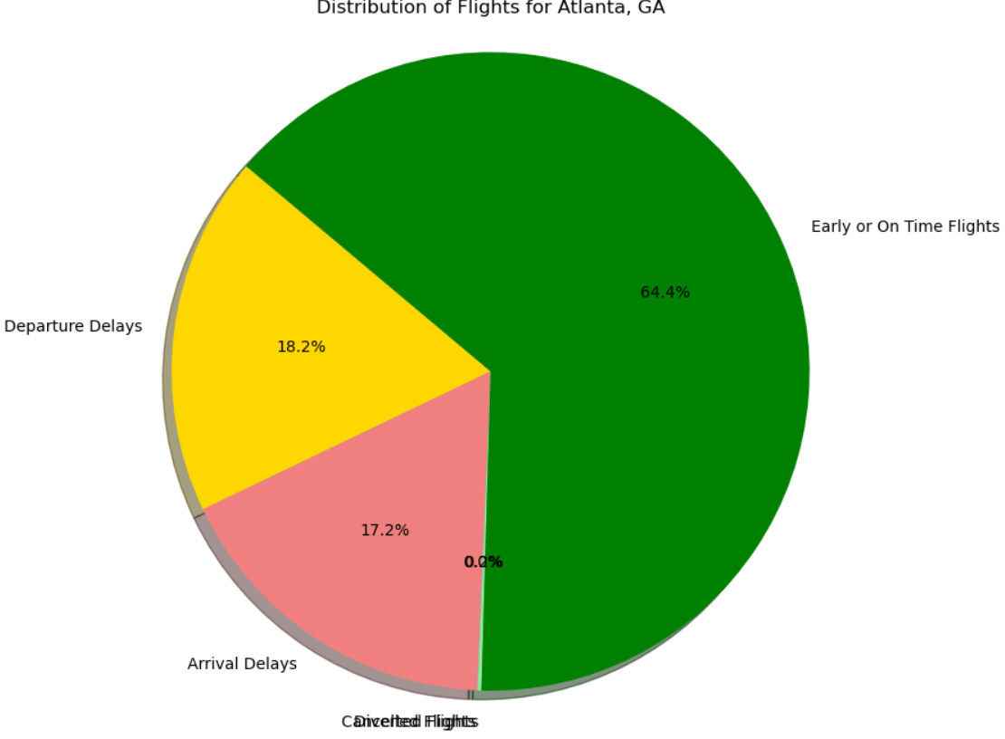
Flight Status
Code Insight: In order to obtain the flight statuses, we set the origin city for both origin and destination city to our designated city name. We also wanted flights that had a delay value greater than zero (to weed out the early flights). Once the arrival delays, departure delays, cancelled, and diverted flight counts were obtained, we took our total number of flights for the designated city and subtracted the other variables counts.
Problem: The amount of cancelled and diverted flights was significantly smaller than other categories, so they were combined into one category for visual purposes.
The Idea: to compare how many flights for each of the 5 airports tested are cancelled or otherwise delayed
Why: This data can be taken to indicate how well a chosen airport operates, as less delayed or cancelled flights is a good indicator of an airport’s operations in coordinating the arrivals and departures of thousands of planes in a month.

Slide 7
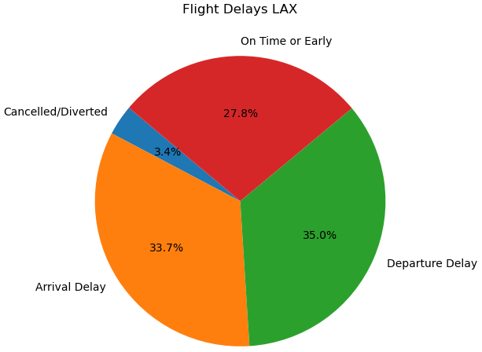
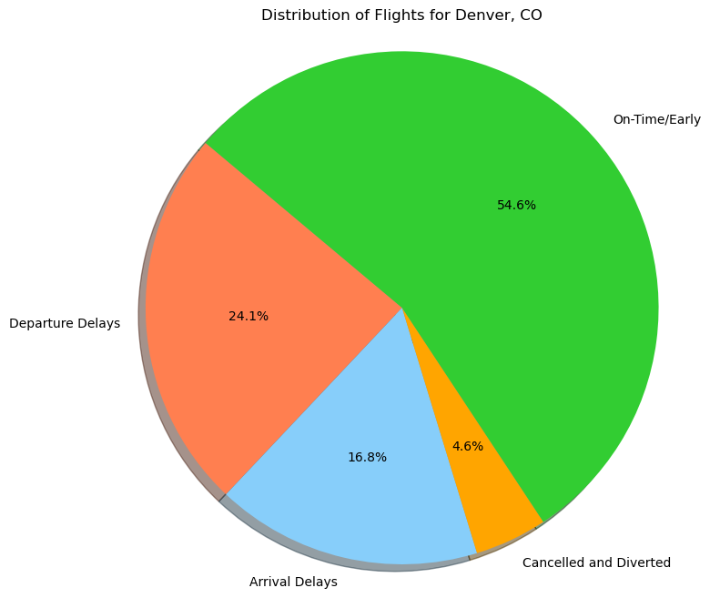
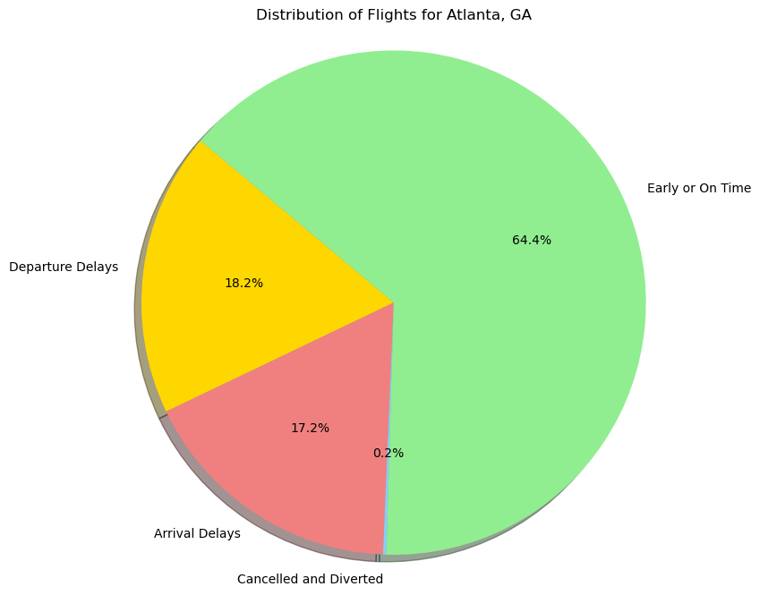
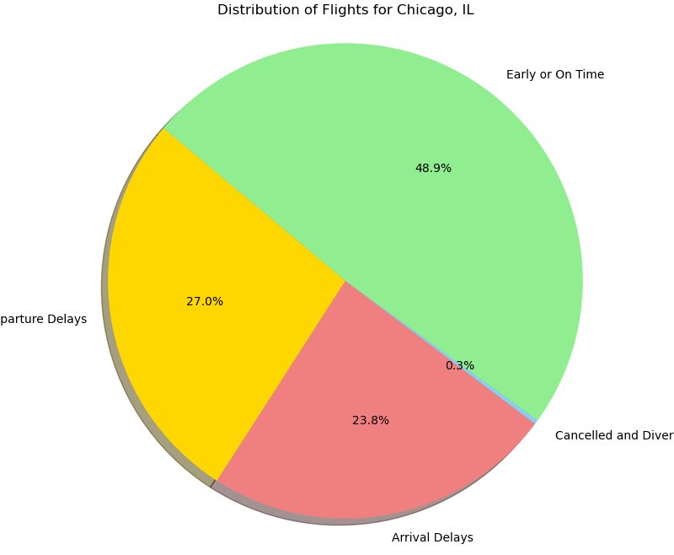
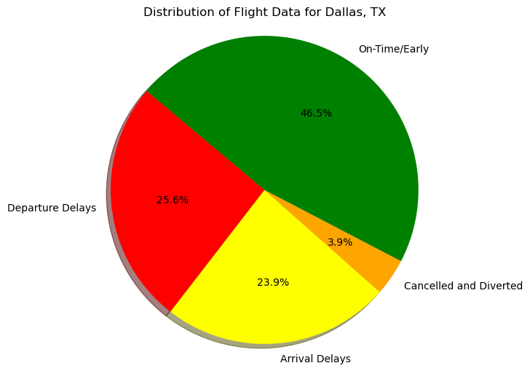
Flight Status

Slide 8
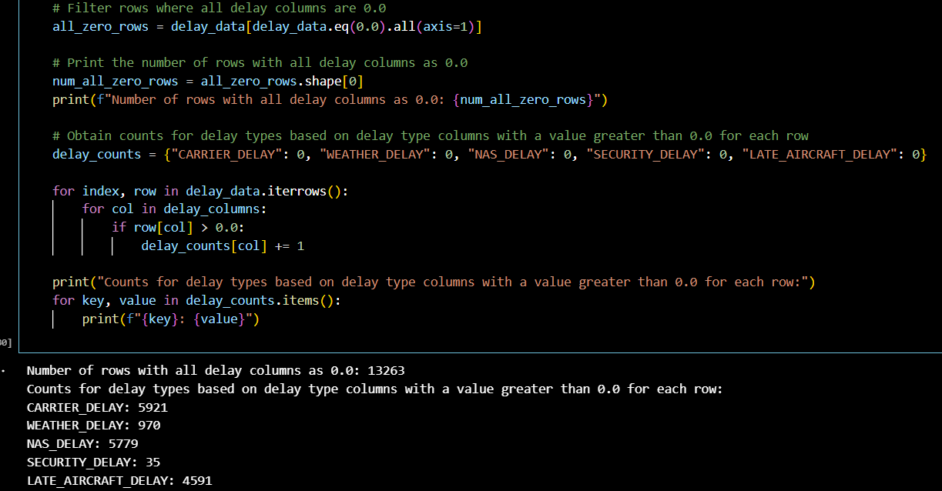
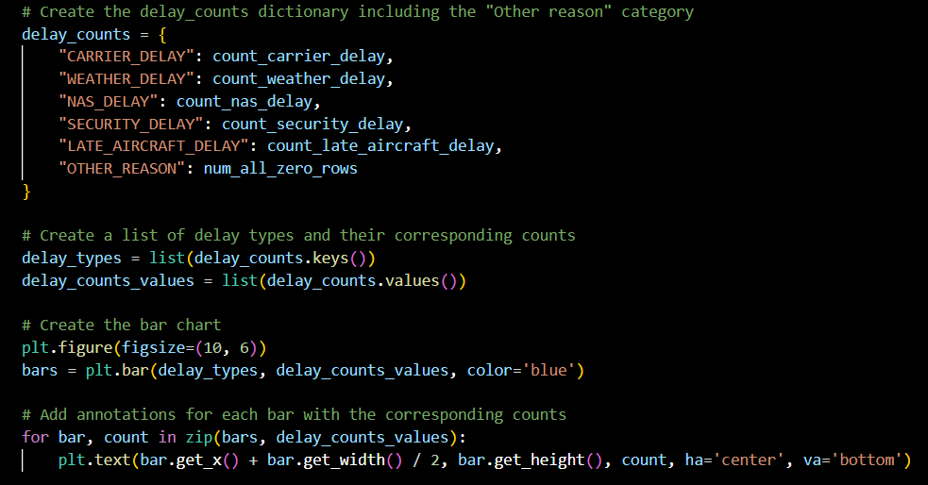
Delay Types
Code Insight: Similarly to the flight status data, each airport’s relevant flights were filtered down to those with positive delay values. Then, each of the 5 columns corresponding to delay reasons were counted for positive values (indicating contribution) as well as delays where no reason was listed.
The Idea: to compare the reasons flight were delayed between the individual reasons and the airports
Why: This data can be analyzed on a per-airport basis to identify problem areas for an airport’s operations, such as security or flight coordination.

Slide 9
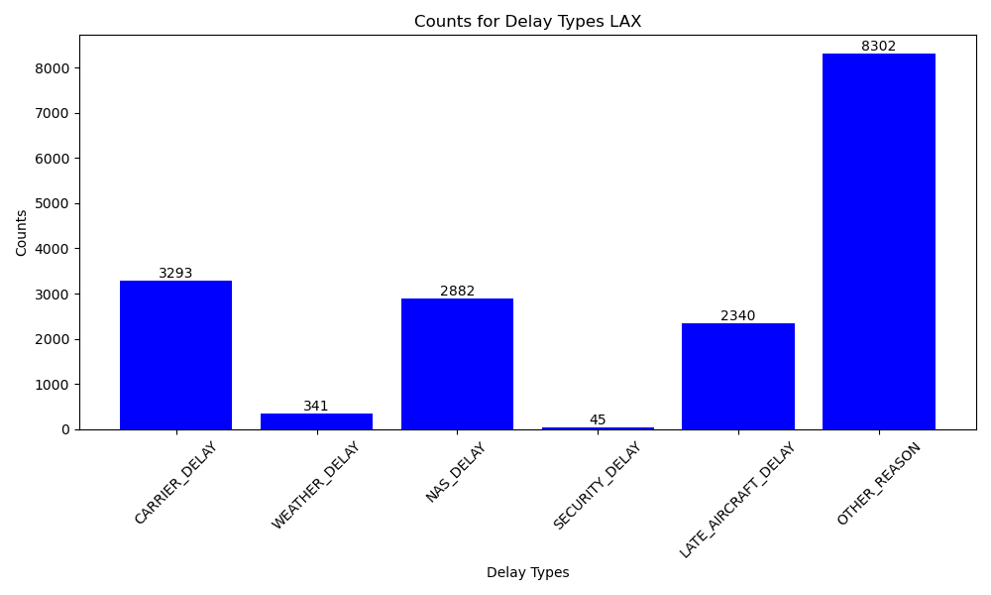
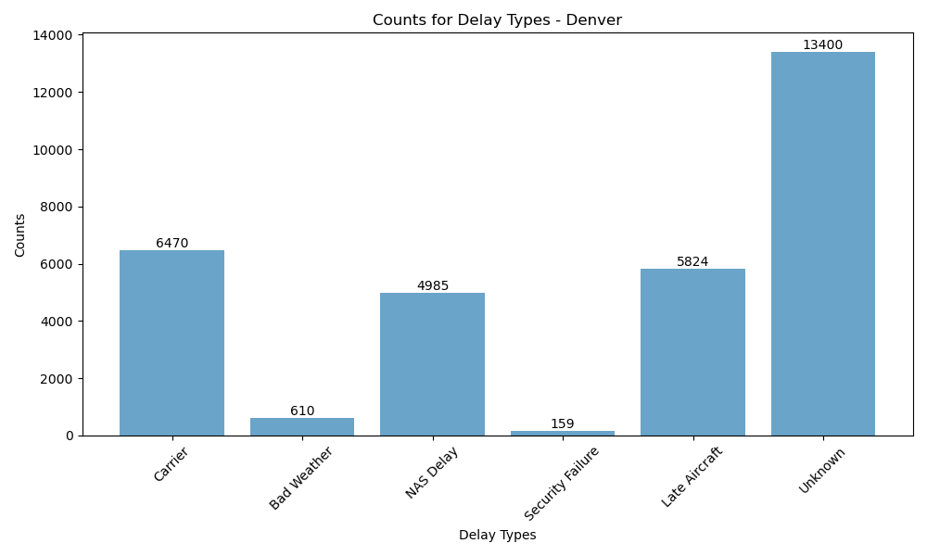
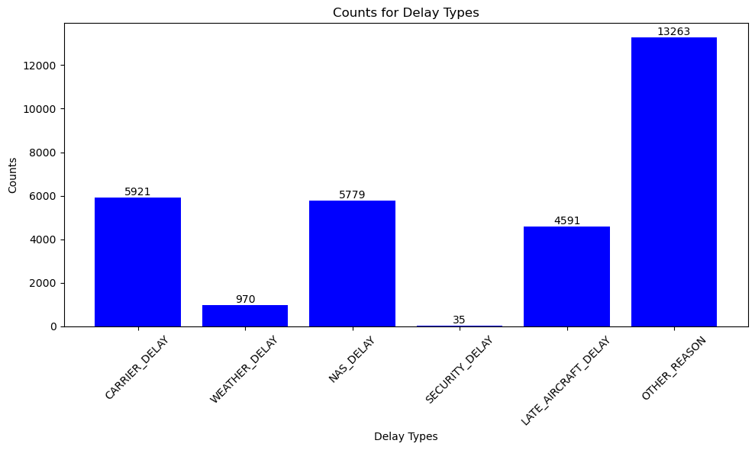
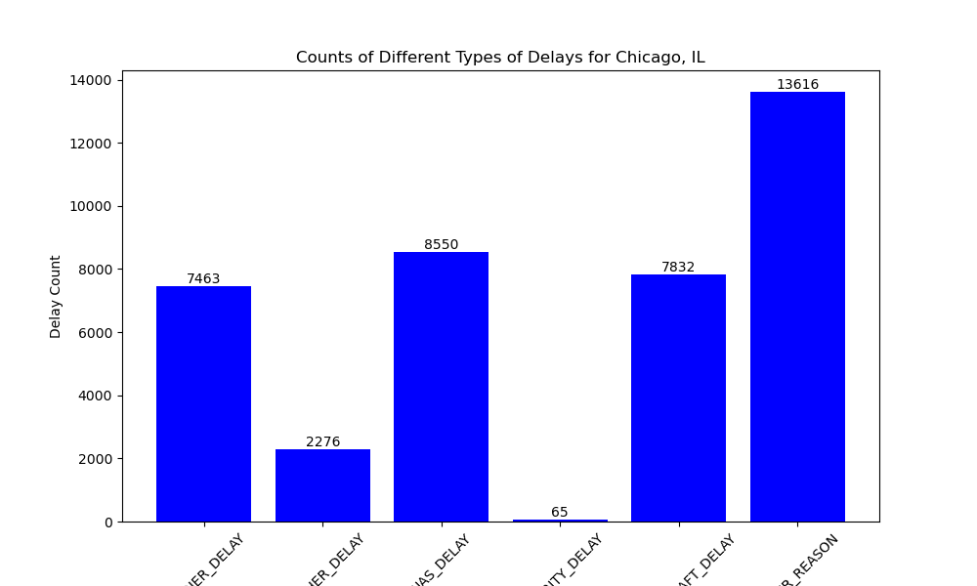
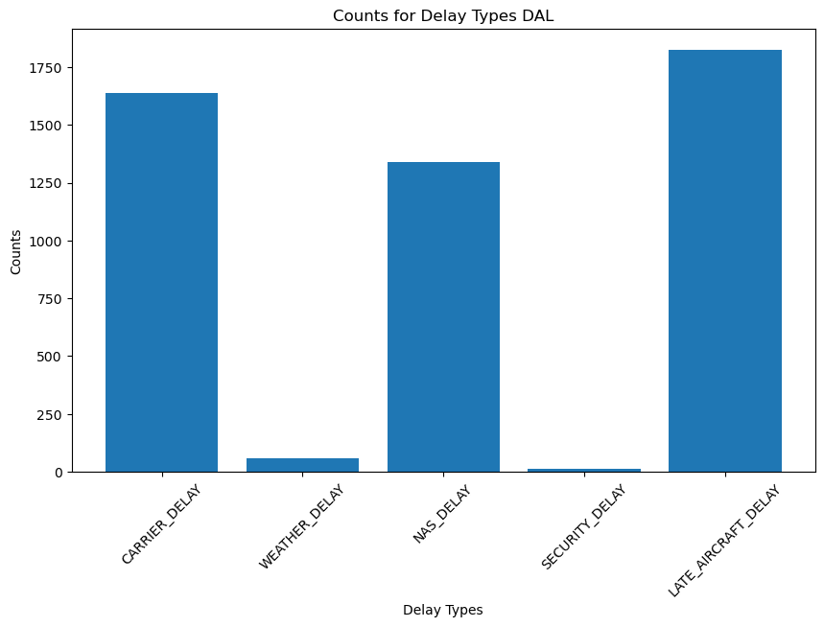
- Atlanta
Delay Types

Slide 10
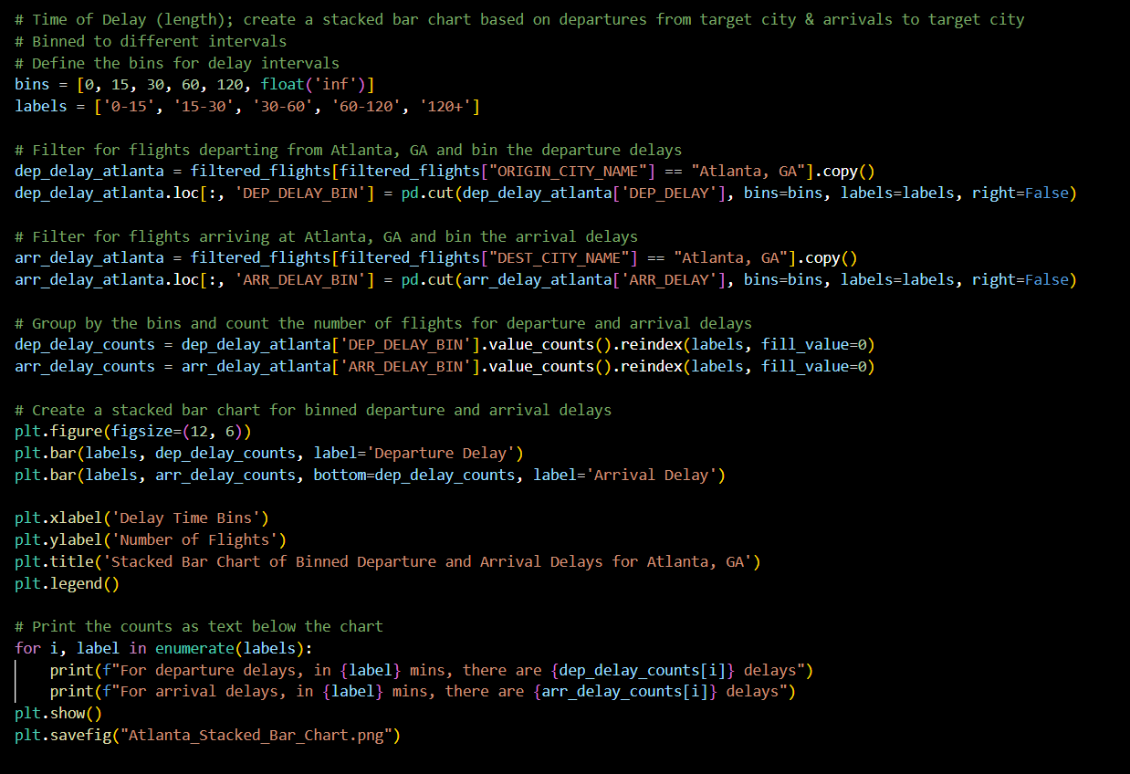
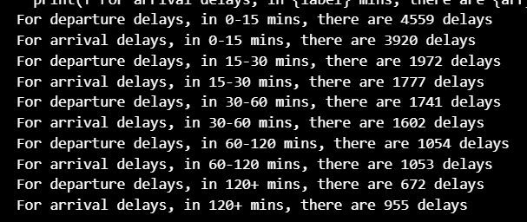
Delay Lengths
Code Insight: For delay times, we wanted a visual showing the amount of flights that fit within a certain time frame. To do so, we binned the data into time frames and created a stacked bar chart for arrival and departure delays.
Problem: The delay counts could not be put onto the visual due to the size of some of the stacks, as the numbers overlapped one another. Instead, we printed the counts.
The Idea: to compare the amount of flights that are delayed and fit into a specific time bin ( 0-15 mins, 15-30 mins, 30-60 mins, 60-120 mins, 120+ mins).
Why: This data can be taken to indicate how many flights are delayed for a given length of time. This gives both patrons and airlines a good idea of how often a flight may be delayed and for what length of time this delay may be.

Slide 11
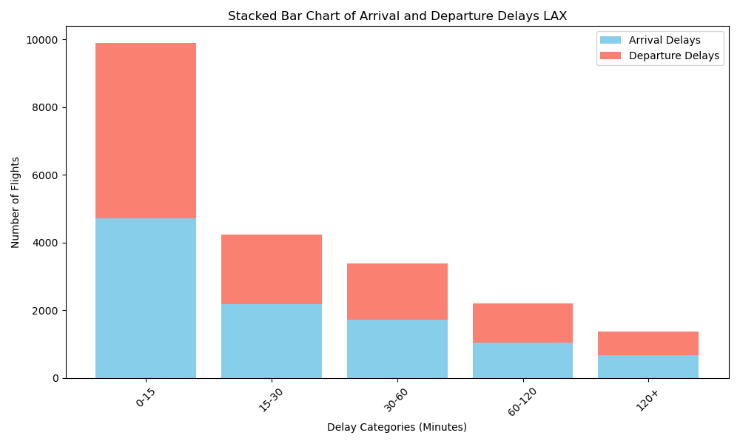
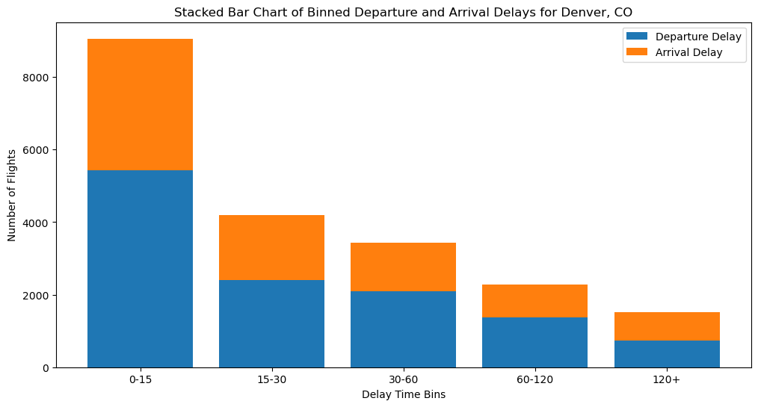
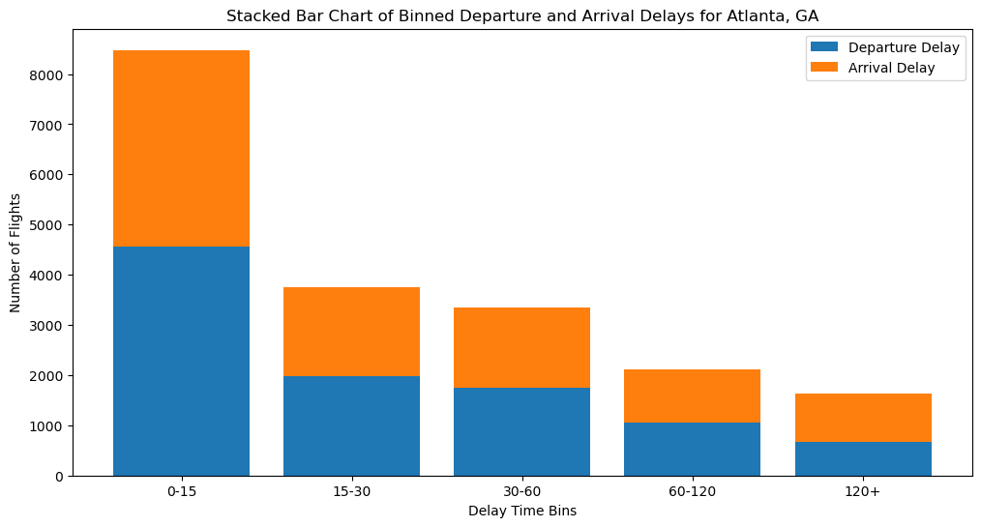
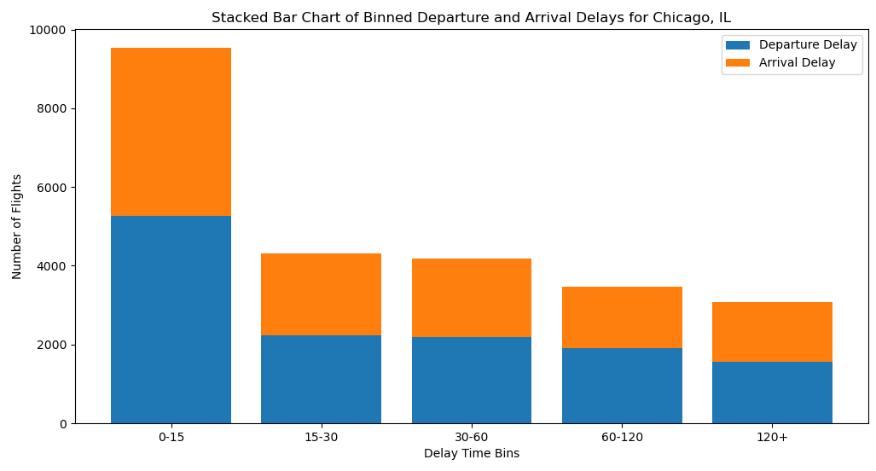
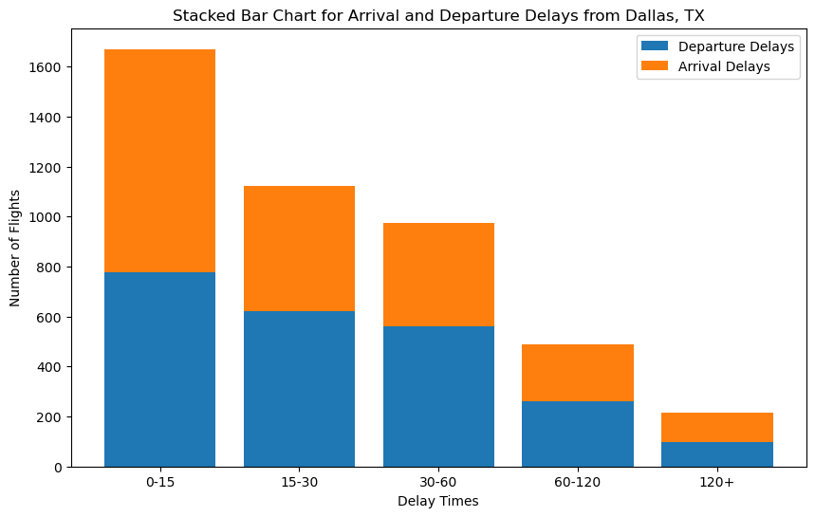
Delay Lengths

Slide 12
Analysis Conclusions
The majority of flight delays are only a few minutes long, so eliminating delays are, logically speaking, a low priority.
Los Angeles needs to invest more in improving general operations to eliminate the majority of their flight delays.
Other airports have specific shortcomings, like Denver’s weight towards departure delays, that warrant investigation.
The size of the unknown data columns in the delay types charts implies that the recordkeeping for delay reasons is not comprehensive enough to cover every cause for delay.

Slide 13
Next Steps
More comprehensive logging of delay reasons
Improvements to time-sensitive operations
Analyze delays in relation to airline companies
Other flight data - international flights, other airports
Cross-referencing data (Types of delays vs. delay lengths)
How could this information be applied, and what could be studied further?

Slide 14
Questions?

Slide 15





The Team
Andrew Pohle
Bryan Thomas
Caitlin Mcmahill
Jessica Maranto
Lauren Graves
Denver, CO Flight Data Handler
Dallas, TX Flight Data Handler
Los Angeles, CA Flight Data Handler
Chicago, IL Flight Data Handler
Atlanta, GA Flight Data Handler

Slide 16
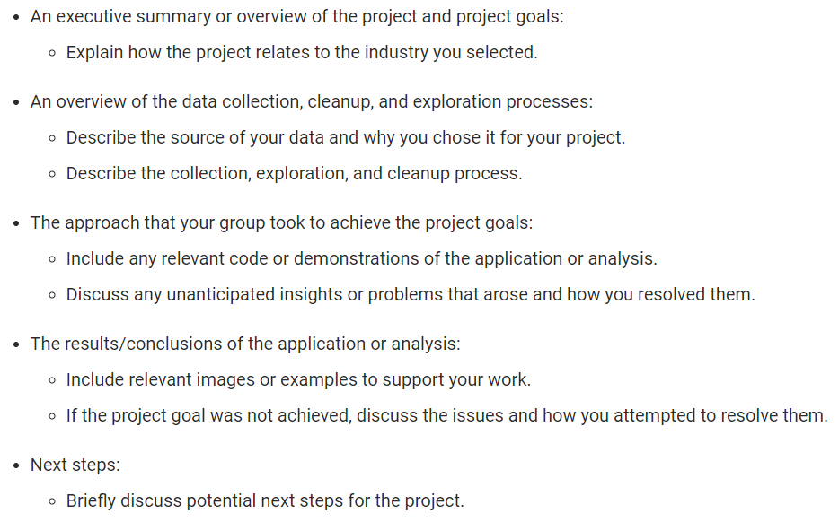
TEMPORARY - presentation outline
Caitlin
Bryan
Slides 3 & 4
Lauren
Slides 6-11
Andrew
Jessica

